Slide 1

CASCaRA
Graph RAG Demo

Slide 2
Team Introductions
Footer Text here

Slide 3
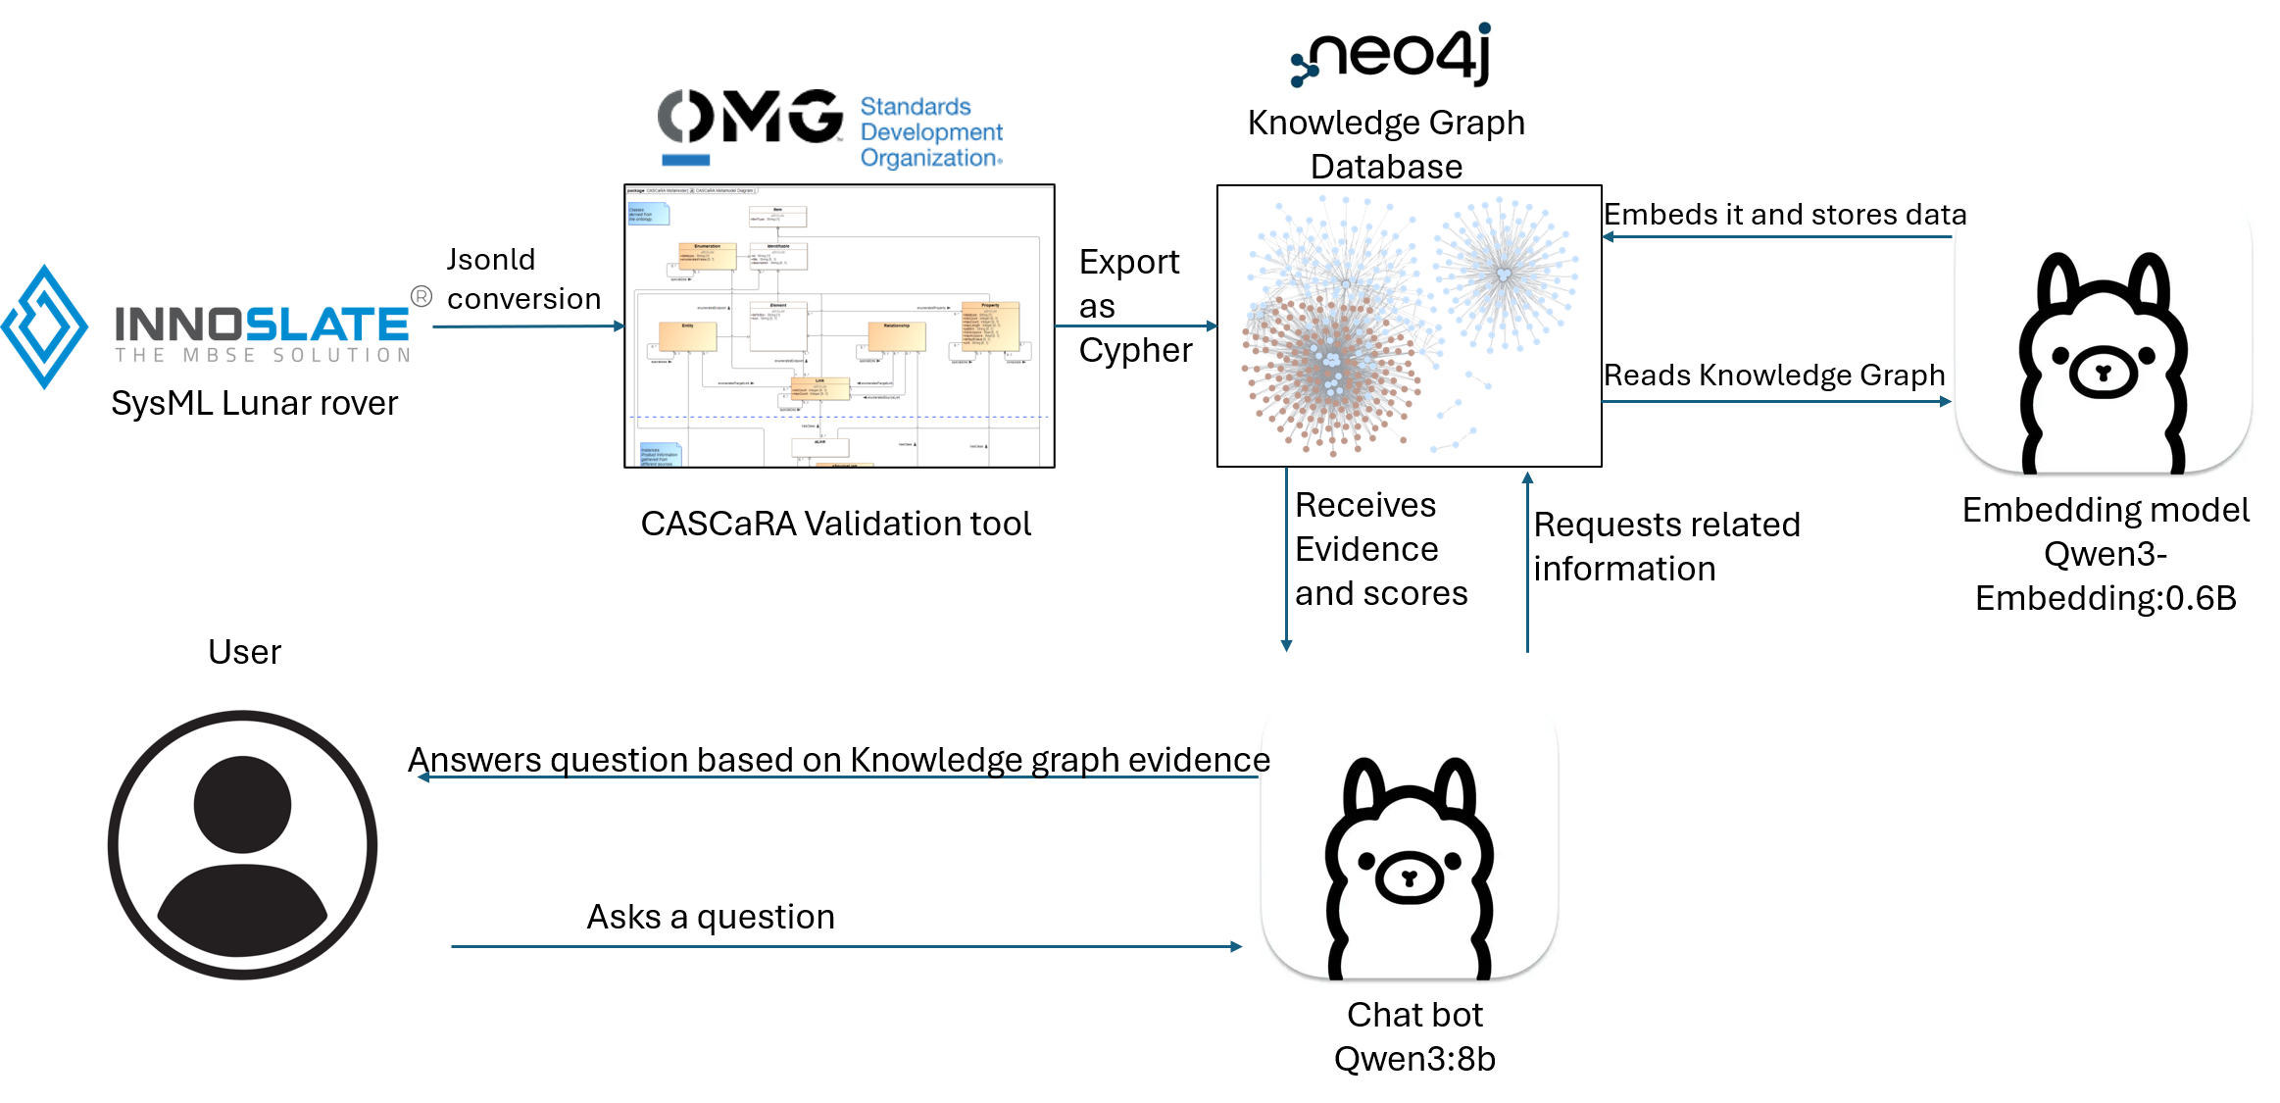
The Demo’s architecture
Footer Text here

Slide 4

Vector search / graph hop hybrid
Embedding
The qwen 0.6 embedding embeds the entire graph to the 1024 dimension.
Vector search
The program will than take that question and embed it and use a mathematical similarity search to find the top 5 seed nodes.
Graph hop
The program now does graph depth search grabbing nodes and having no duplicates and scores them based on Semantic, GDS, and distance.

Slide 5
Scoring evidence
65%
25%
10%
Semantic
GDS
Distance
Similarity of the question to the source of information
Graph Data Science scores it by the relationships and pathing to the node
The distance away from the original Seed node

Slide 6
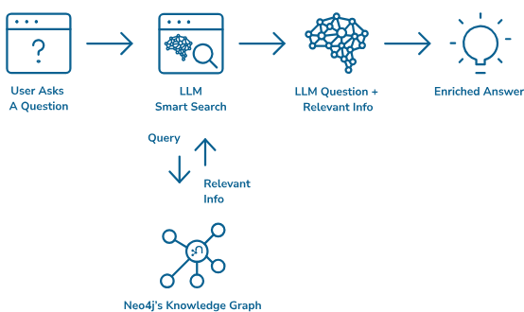
Enhanced Questions and Answers
The user asks the program a question and it answers based on retrieved evidence.
This retrieves evidence faster than humans when mass searching documents
Saves on AI token usage using a structured schema like CASCaRA

Slide 7
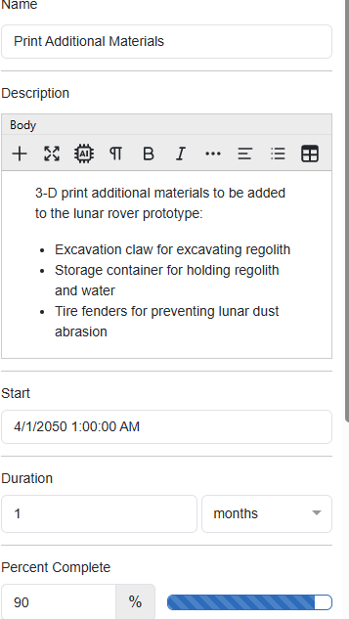
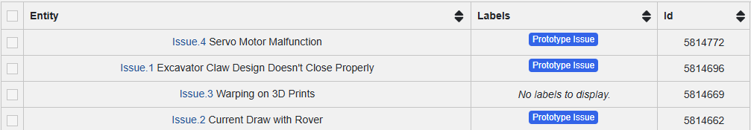

Additional Q&A With images from Innoslate
Question :How many issues exist
=== AI ANSWER ===
The CASCaRA graph evidence indicates that there are **4 issues** explicitly listed as instances of the `inn:C_Issue` class. These are:
1. **Servo Motor Malfunction**
2. **Current Draw with Rover**
3. **Excavator Claw Design Doesn't Close Properly**
4. **Warping on 3D Prints**
These entities are directly associated with the `inn:C_Issue` class through structure or schema relationships, confirming their classification as issues. Other entries reference properties or enumerations of these issues but do not introduce additional distinct issues.
Question: what the average velocity of the rover
=== AI ANSWER ===
The average velocity of the rover is **0.35 m/s** with a tolerance of ±0.05 m/s, as specified in the expected result for the "Average Velocity w/o Max Load Capacity" test case (Evidence 13). This value is directly derived from the test procedure described in the graph.
Question: what the average velocity of the rover
=== AI ANSWER ===
The average velocity of the rover is **0.35 m/s** with a tolerance of ±0.05 m/s, as specified in the expected result for the "Average Velocity w/o Max Load Capacity" test case (Evidence 13). This value is directly derived from the test procedure described in the graph.

Slide 8
Question Slide
Any Questions

